Slide 1


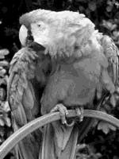



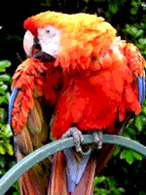

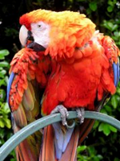
Regularne palete
1- bit (2) 2-bit (4) 4-bit (16) 8-bit (256) 3-bit (8)
6 - bit (64) 9-bit (512) 12-bit (4096) 15-bit (256) 18-bit (32768)

Slide 2
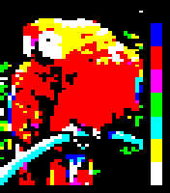
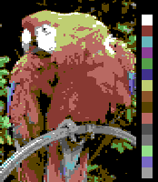
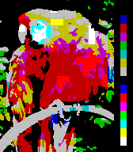
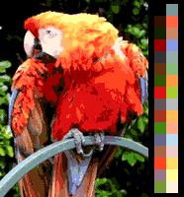

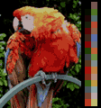
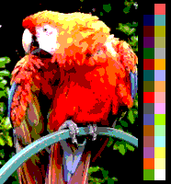
Neregularne palete
Teletext Commodore 64 ZX Spectrum Amiga
Gameboy Gameboy Color Sega Master Sega Game Gear

Slide 3







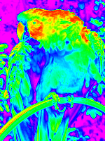
Neregularne palete
4-bit RGBI (16) 3-level RGB (27) 3-3-2 RGB (256) 16-bit RGB (65536)
Windows 16 Windows 20 RiscOS 16 False color image

